Slide 1
AVSHull

Slide 2
AVS Hull
Design
Layout
Waterlines
File Edit
Front View
Side View
Top View
Perspective/Edit view
X
Y
Z
Status, etc.

Slide 3
AVS Hull
Design
Layout
Waterlines
File Edit
Layout Editor
X
Y
Z
Status, etc.

Slide 4
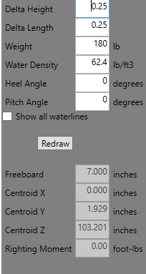
AVS Hull
Design
Layout
Waterlines
File Edit
Show Front
Show Side
Show Top
Waterline Display
X
Y
Z
Status, etc.

Slide 5
AVS Hull
Design
Layout
Waterlines
File Edit
Front View
Side View
Top View
Perspective view
X
Y
Z
Status, etc.

Slide 7
Front View
Side View
Top View
Perspective/Edit view

